Slide 1
Transportation access classification
Using CNNs
Alreem Alkaabi
CSBP301 Artificial Intelligence, Spring 2025

Slide 2
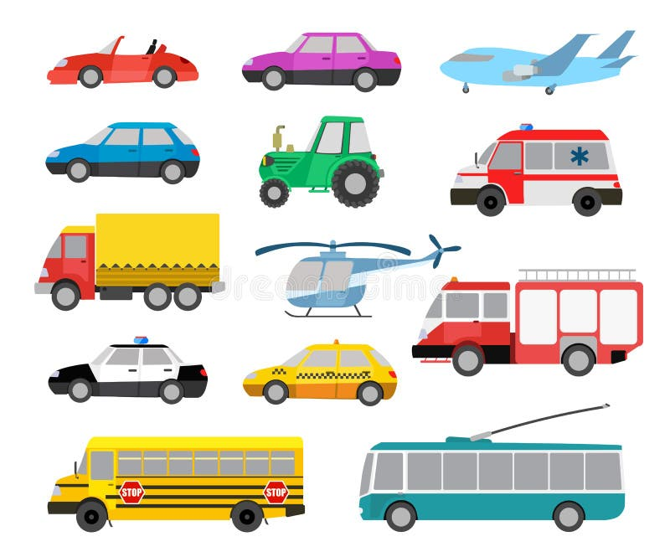
Project goal
Build a model that classifies types of transportation.
small car, scooter = access granted
others = access denied
How?
Using a Conventional Neural Network (CNN)!

Slide 3
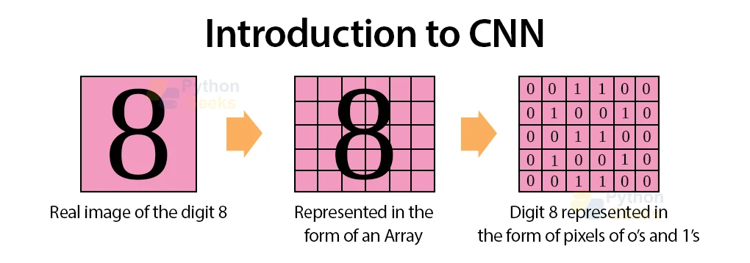
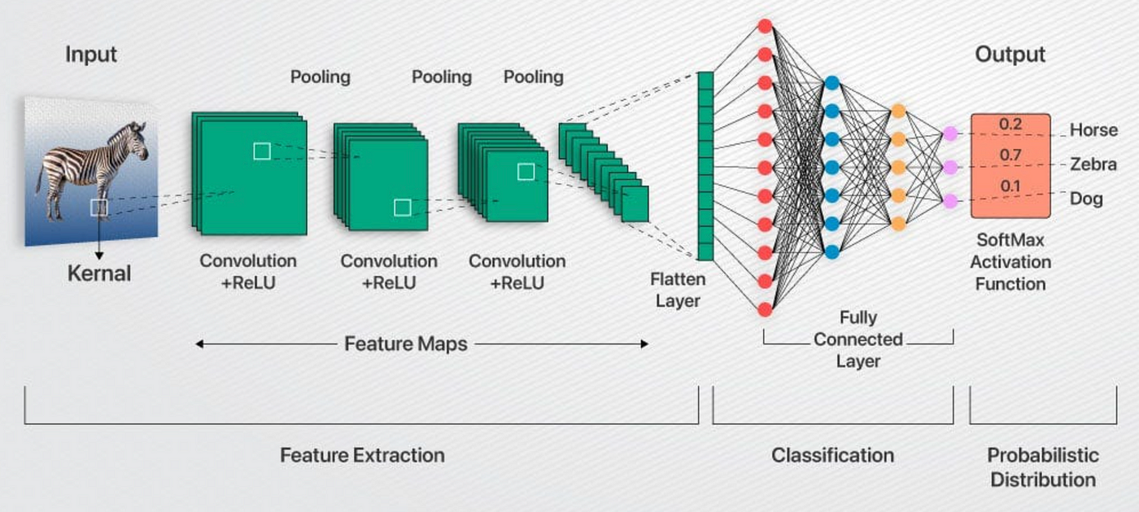
What is a CNN?
Conventional Neural Network.
Useful for classifying images.
It creates filters that recognize feature patterns, to classify images.
Images represented as 2D arrays. (Height, width, and RGB).

Slide 4
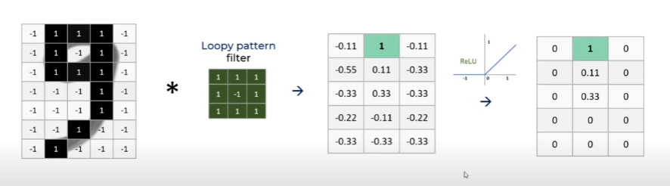
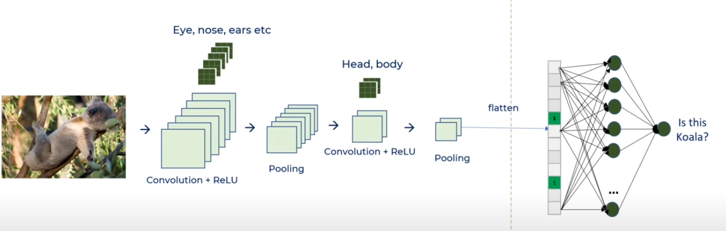
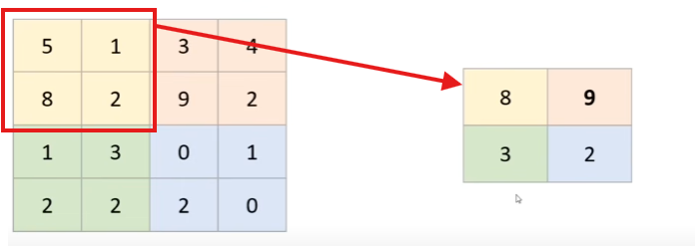
How it works
Input Layer: The image. width x height x depth (3).
convolutional layers: Used to extract features. Applies filters/kernels to the image and generate feature map
Activation Layer: ReLu function, makes negative values 0.
Pooling layer: reduces image size. Faster computation + reduce overfitting.

Slide 5
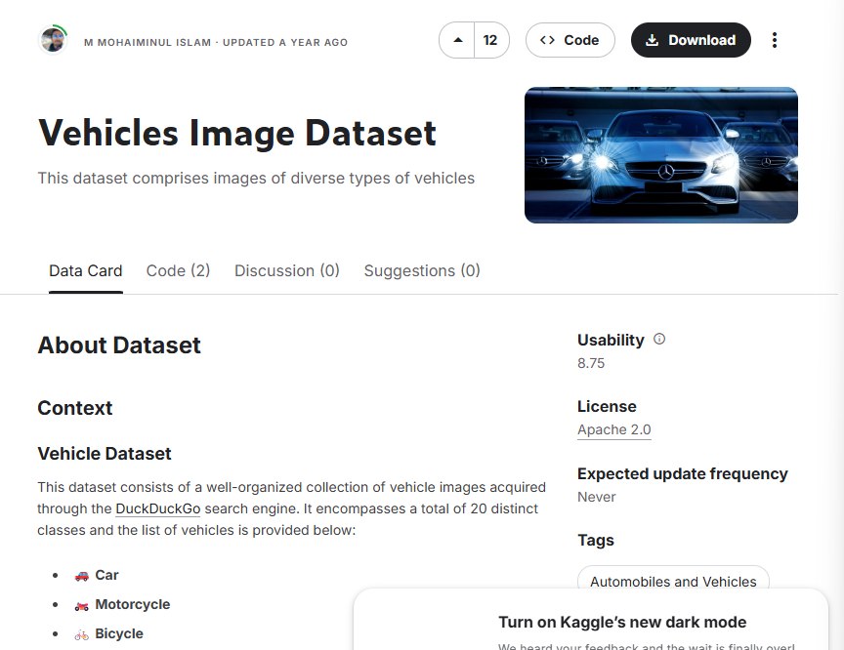
Project Dataset
From Kaggle
https://www.kaggle.com/datasets/mmohaiminulislam/vehicles-image-dataset

Slide 6
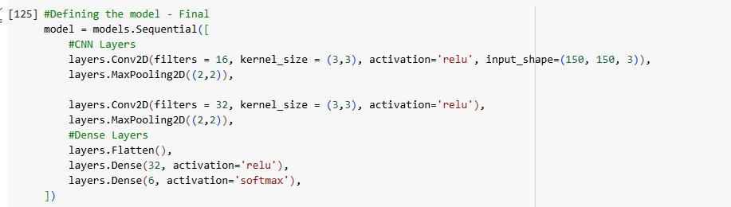
Model Architecture
Input: 150×150 color images (3 channels: RGB)
Convolutional Layer 1:
16 filters, 3×3 kernel size
Activation: ReLU
MaxPooling Layer 1:
2×2 pooling
Convolutional Layer 2:
32 filters, 3×3 kernel size
Activation: ReLU
MaxPooling Layer 2:
2×2 pooling
Flatten Layer:
Converts 2D feature maps into a 1D vector
Dense (Fully Connected) Layer:
32 neurons
Activation: ReLU
Output Layer:
6 neurons (for 6 vehicle classes)
Activation: Softmax (multiclass classification)

Slide 7
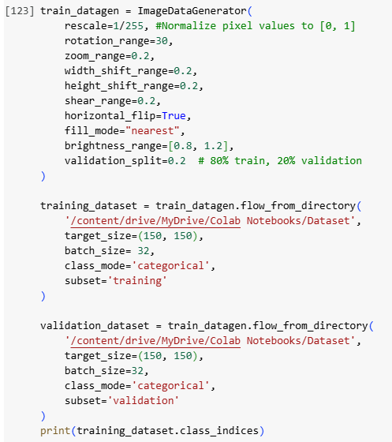
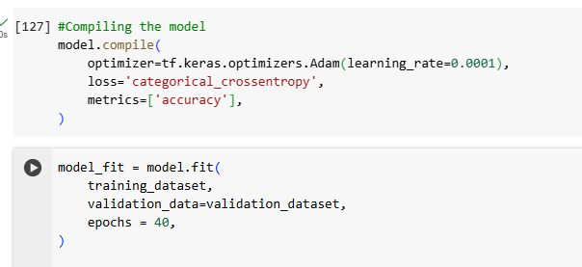
Training Process
Preprocessing: rescale pixel values (0–1)
Data augmentation: rotation, flip, zoom, shift
Optimizer: Adam
40 epochs, batch size 32,150 x 150.

Slide 8
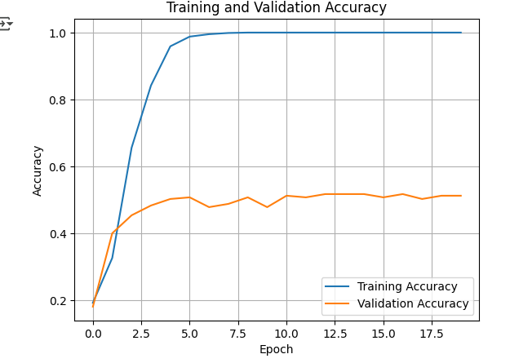
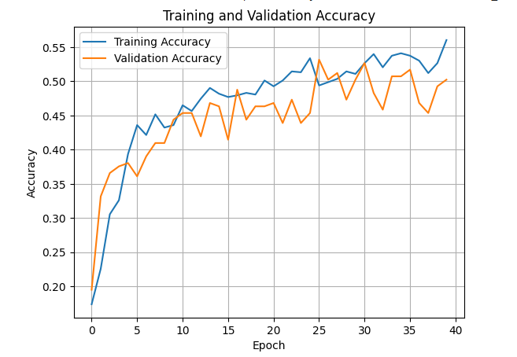
Challenges
Limited dataset size
Overfitting: model memorized training data.
Validation accuracy lower than training accuracy.
Long time to train.
Solutions: augmentation & resizing of images, and redesigning the model, using a different dataset…

Slide 9
Demo
https://colab.research.google.com/drive/1MMA2T12bF5I4FzzUFMh5Ghjq6shznVwB?usp=sharing

Slide 10
Future improvements
Increase dataset size
Try more complex models
Hyperparameter tuning learning rate, batch size, layers

